Slide 1
Turk AI Job Assignment
Alperen Enes Bayar

Slide 2
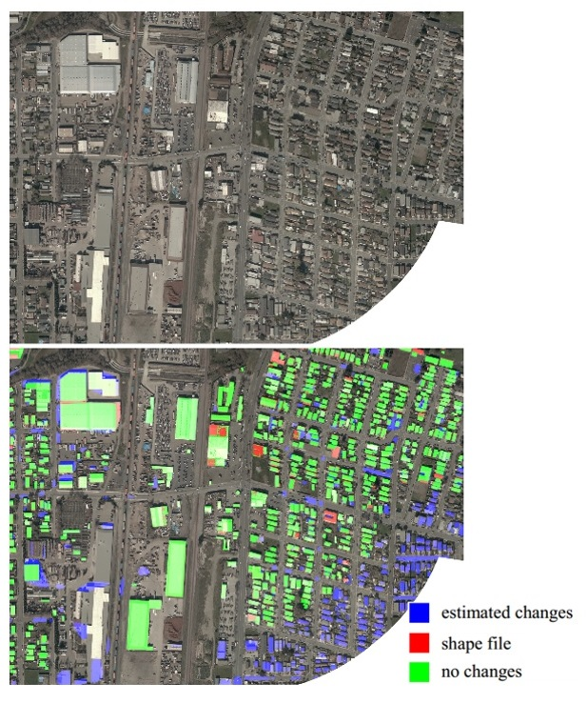
Problem
Visual Surveillance
People Counting
Mapping
Anomaly Detection etc.

Slide 3
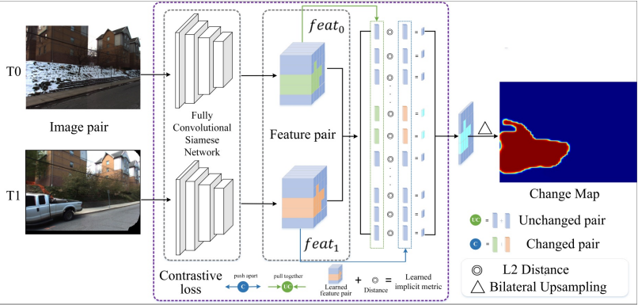
Academic Research
Learning to Measure Changes: Fully Convolutional Siamese Metric Networks for Scene Change Detection 2018 – 70 Citation
Feature extraction model similar to Unet.
Siamese model and segmented the differences.

Slide 4
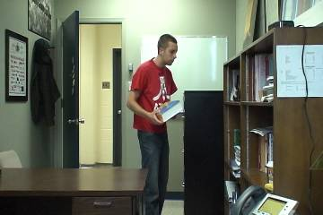
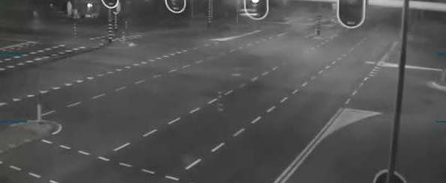
Dataset (CDW-2014)
Street Corner At Night
Office
1980 Train – 220 Test image
1333 Train – 148 Test image

Slide 5


Dataset Classes (CDW-2014)
Unknown motion (usually around moving objects, due to semi-transparency and motion blur)
Color Code: 170
Motion
Color Code: 255

Slide 6


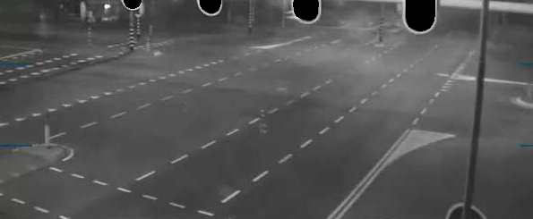
ROI

Slide 7












Augmentation
For Transform:
A.ShiftScaleRotate(rotate_limit=15, shift_limit=0.0625, scale_limit=0.1, p=0.25),
A.HorizontalFlip(p=0.25),
A.VerticalFlip(p=0.25)
For Noise:
A.GaussNoise(var_limit=(2, 10), p=0.2),
A.Blur(blur_limit=1, p=0.2),
A.RandomBrightnessContrast(brightness_limit=0.1, contrast_limit=0.1, p=0.2)

Slide 8
Models
Street Corner At Night
Office
Unet Architecture
ResNet34 Encoder (21M Param)
Imagenet Weight (Transfer Learning)
Unet Architecture
InceptionResNetv2 Encoder (54M Param)
Imagenet+Background Weight (Transfer Learning)

Slide 9



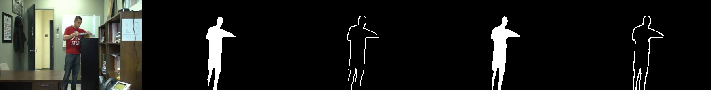

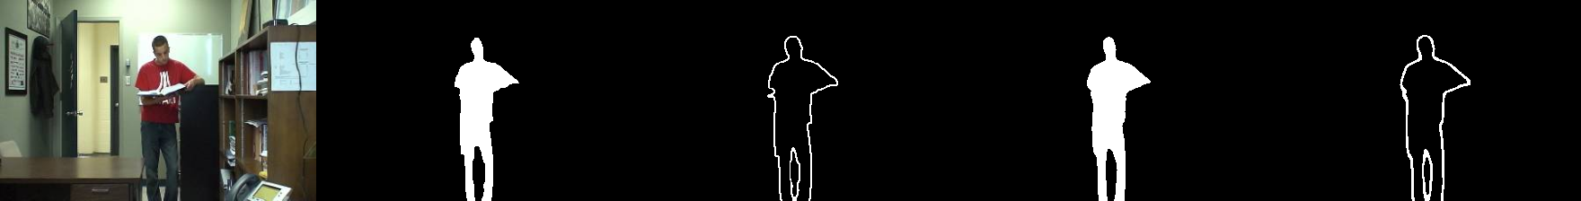

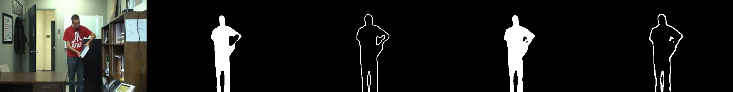

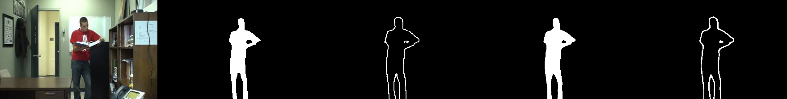
Results
Street Corner At Night
Office
Img – GT1 – GT2 – Pred1 – Pred2
Img – GT1 – GT2 – Pred1 – Pred2

Slide 10

Results (Street Corner At Night)
Img
GT1 – GT2
Pred1 – Pred2

Slide 11
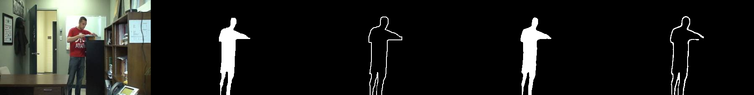
Results (Office)
Img
GT1 – GT2
Pred1 – Pred2

Slide 12
Code: https://github.com/AlperenEnesBayar/TurkAI_Job_Assingment
If you send email or github username for access, I can make it accessible.

Slide 13
Thank You
Alperen Enes Bayar

